Slide 1
Delta Workforce Development Area (DELTA)
Nurse Externship Program
2024
Cindy Goodin
cgoodin@sdpdd.com
(662) 537-2130
Notes:
I am Cindy Goodin with the Workforce Division of South Delta Planning and Development District. We are staff for the Delta Workforce Development Area, or Delta for short.

Slide 2
MISSISSIPPI’S WORKFORCE AREAS
Four Workforce Areas
Each area receives funds to serve residents in their area’s counties
Delta serves residents in the 14-county area in GREEN
7 WIN Job Centers (WJCs) located in the Delta
Delta contracts with MS Hospital Association (MHA) to provide nurse externships for Delta residents
Notes:
The state of MS has 4 workforce areas.
SDPDD receives WIOA funds for the Delta Area.
We contract with (NWCC) and (MDES) to operate 7 WIN Job Centers in our 14-county area and to provide Workforce Innovation and Opportunity Act (WIOA) services to individuals living in the Delta counties.
Delta also contracts with (MHA) to provide Nurse Externships to Delta area residents for Delta area hospitals.

Slide 3
DELTA & MHA CONTRACT
Delta’s Contract with MHA includes:
Time frame: Beginning & Ending Dates
(2/1/2024 – 9/30/2024)
Number of Participants Allowed
(20 participants this year)
Rate of Pay - $12 Per Hour
Maximum Number of Work Hours - 320
Tuition Assistance for Nurse Extern Course is NOT covered by SDPDD/Delta this year
Notes:
Delta’s contract with MHA will begin Feb. 1st and will end Sept 30th
We will allow up to 20 participants to enroll in the Nurse Extern program in 2024.
Our rate of pay continues to be $12 per hour.
Each nurse extern will be allowed 320 hours of work experience.
Make sure the extern does not go over 320 hours – Delta will not pay for any hours over 320

Slide 4
NUMBER OF POSITIONS
NONE
Notes:
You’ll receive this spreadsheet from MHA, which will tell you how many funded positions you have in each of the workforce areas.
Again, Delta will fund 20 nurse externs at $12 per hour.
Delta will NOT be able to provide tuition assistance to students for this nurse externship program.

Slide 5
INSTRUCTIONS:
This form used by every hospital
Extern completes 1st section
Hospital completes 2nd section
Contact appropriate WJC to make appointment for your student
Give student list of items on next slide to take with them to WJC
Extern Completes
Hospital Completes
Notes:
Section 1 – completed by Extern
Section 2 – completed by Hospital
Hospital makes an appointment for the student with a specific WIN Job Center based on the Student’s county of residence.
For Example: if a student lives in Batesville, you’d contact the Batesville WIN Job Center to be processed for WIOA Nurse Externship funding.
Give the Student the following list of items to take with them………..

Slide 6
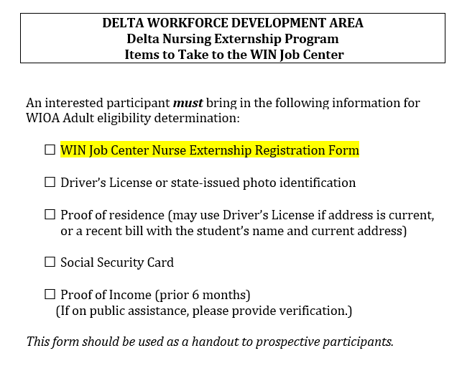
WORKSITE SUPERVISOR SENDS STUDENT TO WJC
Provide student with this list of items to take to WJC
Students will NOT be certified without ALL of this information
Feel free to duplicate list for your use
Notes:
You’ll inform the student what they must take with them to the WJC in order to be determined eligible for the extern program.

Slide 7
Which WJC Do You Send Your Nurse Extern?
QUESTION:
Does your Nurse Extern already have an ITA?
If Yes – Send to WJC handling the ITA
If No - Where does your Nurse Extern live?
Batesville WJC | Clarksdale WJC | Cleveland WJC | Greenville WJC | Greenwood & Lexington | Indianola WJC
Panola | Coahoma | Bolivar | Humphreys | Carroll | Sunflower
Quitman |  |  | Issaquena | Holmes
Tallahatchie |  |  | Sharkey | Leflore
Tunica |  |  | Washington
Delta will not pay for Externship if your Nurse Extern does not live in one of the above counties
Extern should contact workforce area that serves Extern’s county of resident
Notes:
How to determine which WJC to send your extern?
First, ask if the nurse extern already receives WIOA funding (money from a WJC for their nursing degree) from a WJC.
* If they do, send them back to that same WJC – make an appointment for them
* If they do NOT, schedule an appointment and send them to the appropriate WJC based on this chart.

Slide 8
Which WJC?
Batesville Jordan Latham 662-360-1237 jlatham@northwestms.edu The Concourse 325 Lakewood Drive Batesville
Clarksdale Summer Holmes 662-624-9001 sholmes@mdes.ms.gov 236 Sharkey Ave., 3rd Floor Clarksdale
Cleveland Stephanie Williams 662-843-2704 stewilli@mdes.ms.gov 119 Commerce Avenue Cleveland
Greenville
Vanessa Tijero
662-332-8101
itjero@mdes.ms.gov
800 Martin Luther King,
Suite C54
Greenville
Greenwood/Lexington
Elmer O’Neal-Lacy
662-459-4623
eoneal-lacy@mdes.ms.gov
812 W. Park Avenue
Greenwood
Indianola
Lillie Johnson
662-887-2502
landerson@mdes.ms.gov
226 N. Martin Luther King Drive
Indianola
Must live in:
Bolivar
Carroll
Coahoma
Holmes
Humphreys
Issaquena
Leflore
Panola
Quitman
Sharkey
Sunflower
Tallahatchie
Tunica
Washington
Notes:
Each worksite supervisor will determine which WJC a student should go to for WIOA processing.
Students must live in one of these 14 counties to be eligible for Delta WIOA funds.
The worksite supervisor completes the top half of the form and instructs the student to take this form with them to a specific WJC…again, based on where the student lives or where the student is already receiving WIOA funds for their nursing degree.

Slide 9
INSTRUCTIONS:
WJC Representative completes 3rd section
Extern returns completed form to hospital
Hospital sends copy to:
rpowell@mhanet.org
AND completes spreadsheet on following slide to also send to Robin
Notes:
The WJC completes section three and sends the student back to the hospital’s point of contact with the form.
The point of contact sends a copy of the completed form to Robin along with the following spreadsheet.

Slide 10
LIST OF STUDENT EXTERNS
Notes:
The Point of Contact adds the student’s information to this spreadsheet and emails it to Robin.
Note the circled areas.
As time goes on and you see you will not use all of your slots, PLEASE notify Robin so that those slots may be used by another hospital.

Slide 11
2024 CERTIFICATION OF COMPLETION
1. MHA provides a
“Certification of
Completion” to each
Extern
2. Robin will email to:
Worksite
WJC
2024
Notes:
Here is an example of the 2020 certificate as issued by MHA…I added 2024 on the form just to reflect the upcoming externship year.

Slide 12
Notes:
Does anybody have any questions or concerns we need to address?

Slide 13
Delta Workforce Development Area
Nurse Externship Program
2024
Cindy Goodin
cgoodin@sdpdd.com
662-537-2130
Notes:
Here is my contact information if you need to reach out to me for anything…

